Slide 1
IoT-ENABLED PUBLIC SAFETY AND EMERGENCY RESPONSE SYSTEM
Presentation by, Guided by,
Arun Prakaash C Dr. Vinothkumar C

Slide 2
OUTLINE
Objective
Literature Survey
Proposed Methodology
Block Diagram
Project Components
Surveillance Subsystem
Electronics Subsystem
Visualization and Monitoring
Conclusion
References

Slide 3
OBJECTIVES
Enhance Urban Security: Implement smart surveillance to monitor restricted spaces in real time and detect potential threats.
Increase Fire Safety: Integrate smart fire detection and prevention systems to ensure early warning and rapid response to fire incidents.
Effective Nighttime Lighting: Deploy adaptive street lighting that adjusts brightness based on pedestrian and vehicle presence to improve safety in poorly lit areas.
Provide Immediate Assistance: Install smart panic buttons in public spaces to allow citizens to quickly alert authorities in emergencies.

Slide 4
LITERATURE SURVEY
TITLE | METHODOLOGY IMPLEMENTED | LIMITATION
TOPIC : IoT-Enabled Autonomous System Collaboration for Disaster-Area Management AUTHORS: Minh Binh Lam, Trung-Hau Nguyen, Andwan-Young Chung JOURNAL: IEEE Access , April 2020 | The authors developed a framework that allows various autonomous systems (drones, sensors, vehicles) to communicate and work together in disaster management. These autonomous systems coordinate to detect hazards, assess the extent of damage, and optimize rescue operations. The framework supports continuous real-time data exchange between the autonomous systems, enabling swift decision-making during disaster relief efforts. | The effectiveness of the system is limited by the availability of network connectivity in disaster-affected areas, which can be unreliable or non-existent. The study has not been extensively tested in real-world, large-scale disaster scenarios, raising concerns about its practical viability in such conditions. The framework's ability to scale and maintain functionality in widespread, severe disaster conditions remains uncertain.

Slide 5
LITERATURE SURVEY
TITLE | METHODOLOGY IMPLEMENTED | LIMITATION
TOPIC : The Role of IoT in Enhancing Public Safety in Smart Cities AUTHORS: S. Ebadinezhad, M. S. M. Abdalkarim, Z. Deen, F. M. Kiminou Nsimba JOURNAL: IEEE Access , April 2020 | IoT-based devices and sensors are embedded within key urban systems such as surveillance, transportation, and emergency response. The system continuously gathers data from various sensors across the city, providing a real-time view of public safety conditions. Advanced data analytics processes the collected data to identify potential public safety threats like crimes, accidents, and fire outbreaks. Once a threat is detected, the system triggers real-time responses, notifying authorities and initiating actions to mitigate the threat. | Potential cybersecurity risks, such as hacking or data breaches within the IoT infrastructure, are not thoroughly discussed, leaving questions about how secure these systems are in practice. The paper overlooks the significant financial burden of deploying and maintaining IoT infrastructure across an entire city, which may be prohibitive for many municipalities. The study does not consider the complexities of scaling IoT solutions to larger area.

Slide 6
LITERATURE SURVEY
TITLE | METHODOLOGY IMPLEMENTED | LIMITATION
TOPIC : Securing Lives and Assets: IoT-Based Earthquake and Fire Detection for Real-Time Monitoring and Safety AUTHORS:R. Singh, R. Sharma, K. Kumar, M. Singh, P. Vajpayee JOURNAL: IEEE Access , April 2020 | The authors propose a system that employs IoT sensors to monitor environmental changes and detect anomalies related to earthquakes and fires. The system is designed to detect early signs of disasters and automatically transmit critical data to a centralized system for rapid intervention by authorities. The solution incorporates secure data transmission to ensure reliability during emergencies, preventing data tampering or loss during critical moments. All collected data is sent to a centralized hub, allowing for coordinated responses to emerging threats. | The study does not provide detailed insights into how the system can be optimized for large-scale or city-wide deployment, limiting its scalability potential. The paper does not address how the system manages false alarms or inaccurate sensor readings, which could lead to unnecessary responses or failure to detect actual threats. The system's capacity to scale and maintain accurate performance in densely populated urban areas is not fully explored.

Slide 7
PROPOSED METHODOLOGY
Surveillance Monitoring:
Deploy cameras to capture live video.
Utilize motion detection to spot threats.
Send alerts to the control unit for quick action.
Fire Detection and Prevention:
Install smoke and temperature sensors to detect fire risks.
Activate sprinklers automatically when needed.
Send early warnings to the central hub and fire teams.
Adaptive Street Lighting:
Integrate motion sensors to detect people and vehicles.
Adjust streetlight brightness for better visibility.
Reduce energy use while maintaining safety.
Emergency Panic System:
Place panic buttons in key public locations.
Trigger instant alerts with location details when pressed.
Ensure quick response for people in emergencies.

Slide 8
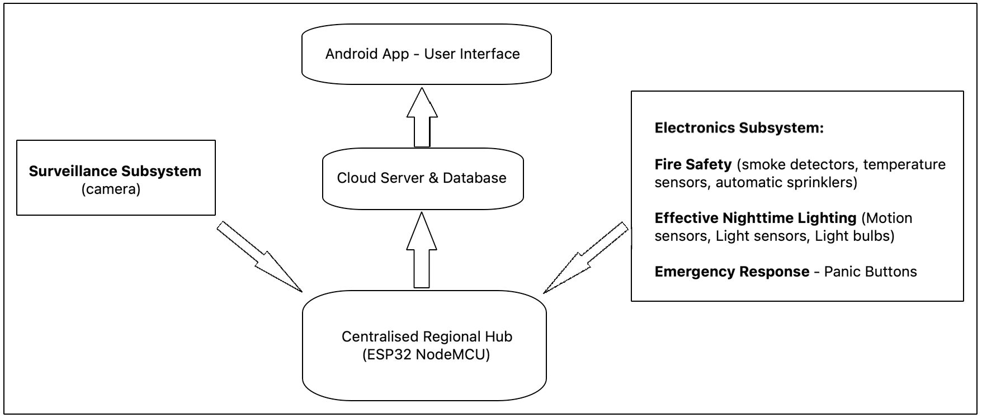
BLOCK DIAGRAM

Slide 9
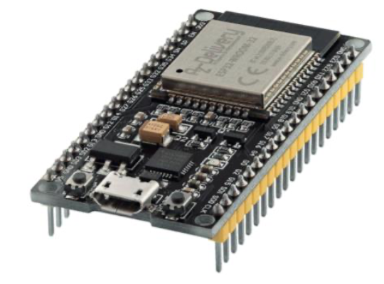
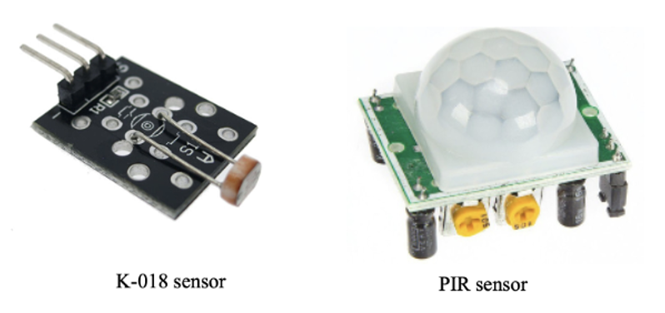
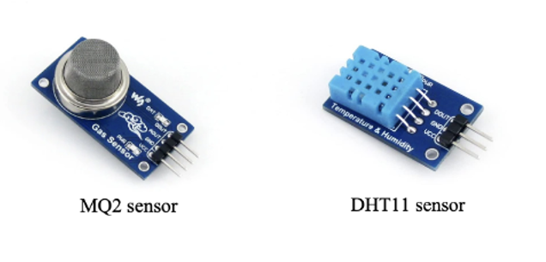
PROJECT COMPONENTS
Hardware Components:
Camera
Microcontroller: ESP32 NodeMCU
MQ-2 Gas Sensor: Detects gas leaks and air quality.
DHT11 Sensor: Monitors temperature and humidity.
HC-SR501 PIR Motion Sensor: Detects motion.
K-018 LDR Sensor: Measures light levels.
ESP32 NodeMCU

Slide 10
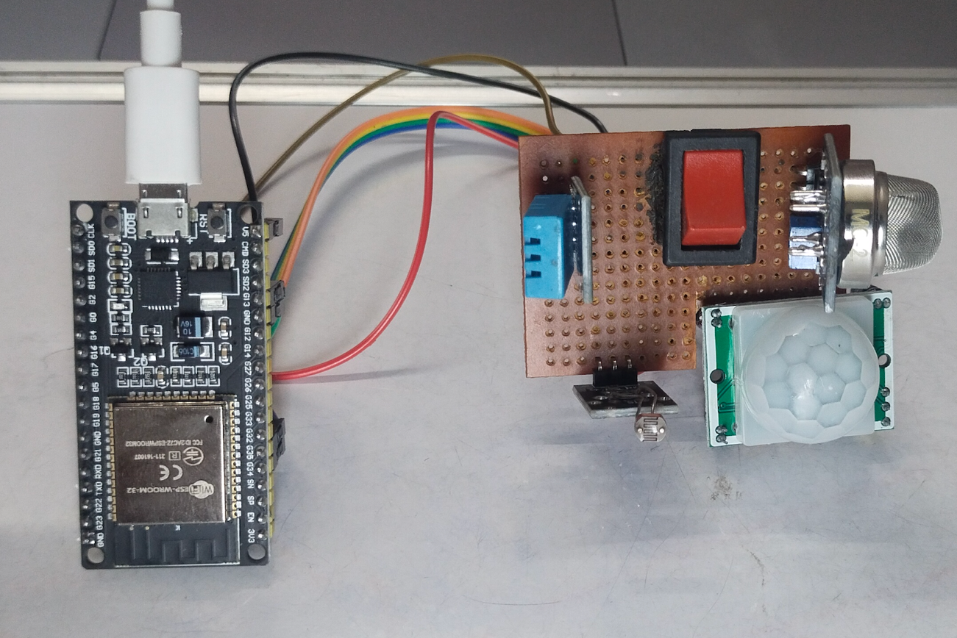
PROJECT COMPONENTS
Electronic Module

Slide 11
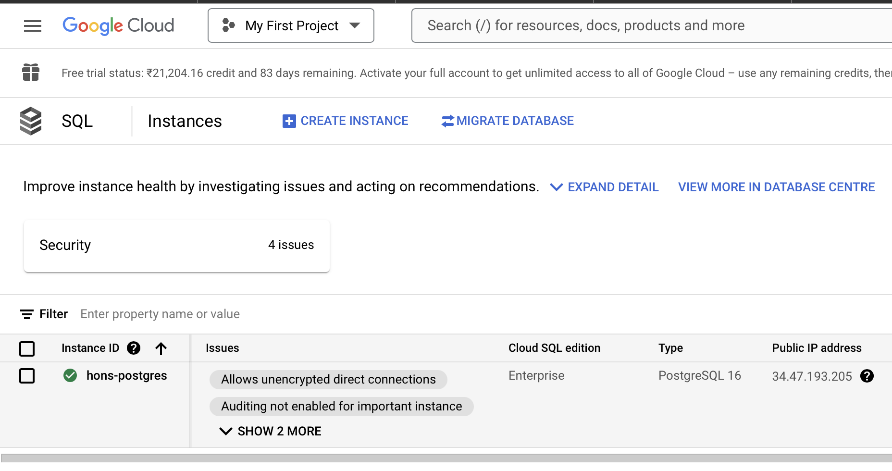
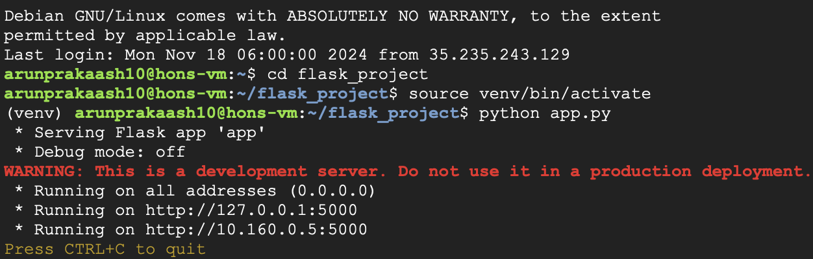
PROJECT COMPONENTS
Software Components:
Google cloud PostgreSQL instance
Google cloud Virtual Machine – to run REST API
PostgreSQL instance
REST API Activation in Cloud VM

Slide 12
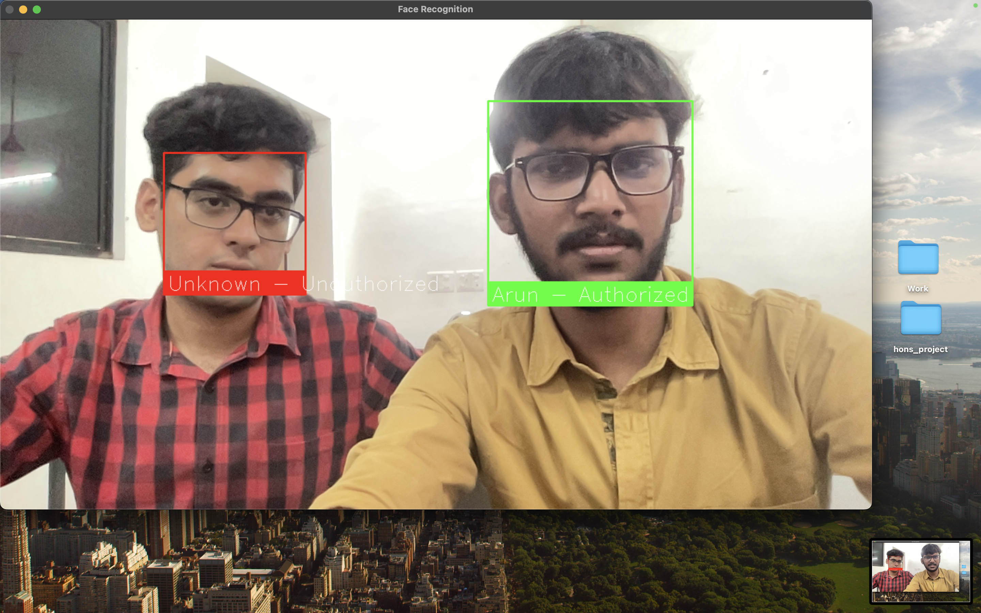
SURVEILLANCE SUBSYSTEM
Objectives:
Enable real-time detection and identification of individuals.
Securely log data for real-time and retrospective analysis.
Seamlessly integrate with cloud platforms for scalable storage and advanced analytics.
Real-time facial recognition

Slide 13
SURVEILLANCE SUBSYSTEM
Workflow:
Face Detection and Encoding:
Cameras capture video frames.
Unique facial features are encoded into numerical vectors for comparison.
Authorization Check:
Encoded vectors are compared against a pre-trained database of known faces.
Identities are verified for authorization status.
Data Logging:
Details such as name, status (authorized/unauthorized), and timestamp are recorded in a PostgreSQL database.
Unauthorized entries are flagged for security alerts.
Real-Time Feedback:
Video feed overlays indicate individuals:
Green: Authorized.
Red: Unauthorized.

Slide 14
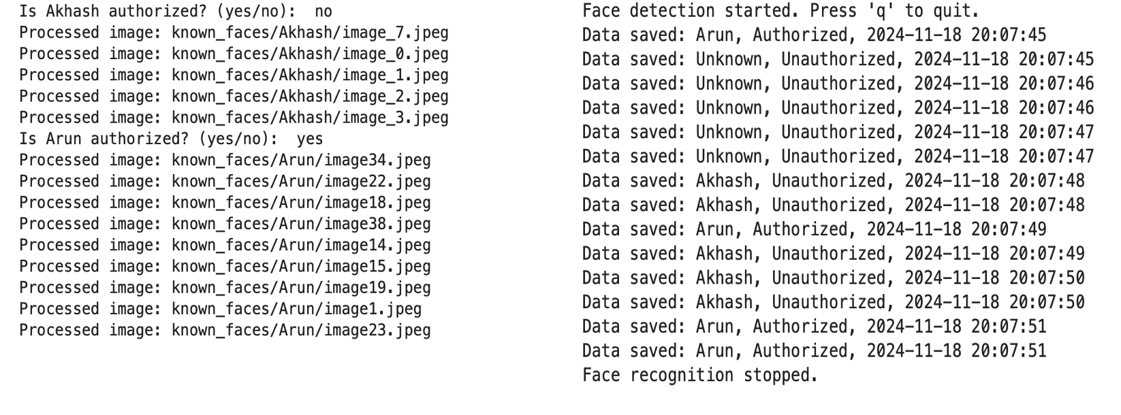
SURVEILLANCE SUBSYSTEM
Training Implementation
Detection Output

Slide 15
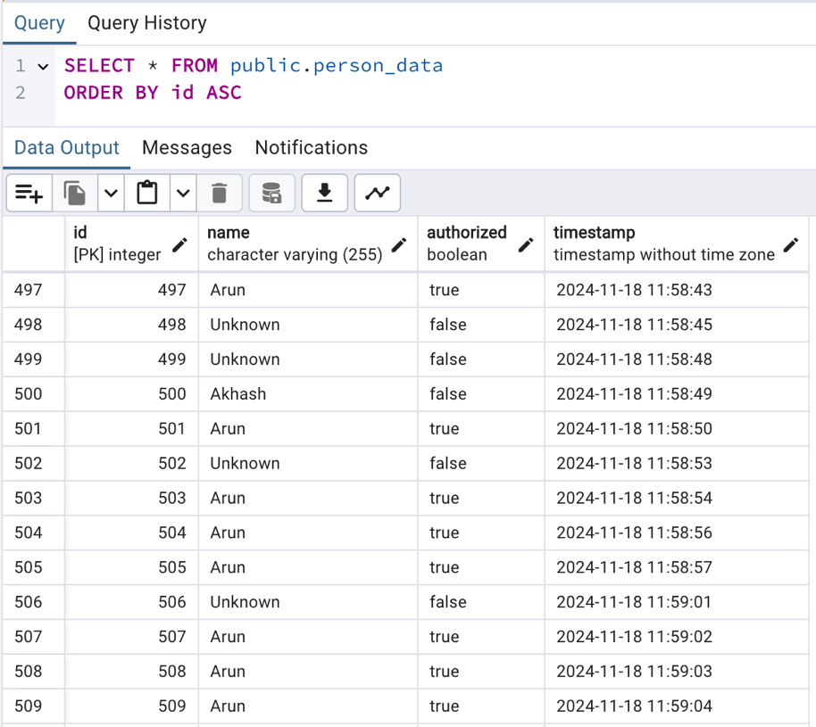
SURVEILLANCE SUBSYSTEM
Data is stored in cloud PostgreSQL database, in the table ”person_data” with fields: id, name, authorization status and timestamp
person_data cloud-SQ table contents

Slide 16
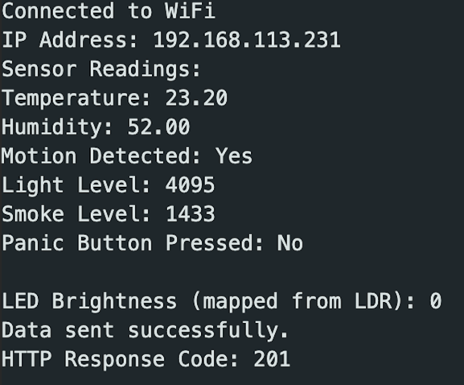
ELECTRONICS SUBSYSTEM
Sensor Interfacing and Data Collection:
Sensor Readings:
Fetched at regular intervals using non-blocking delay loops for efficiency.
Data Normalization:
Example: Light sensor values (0–4095) normalized to brightness levels (0–255) for LED control.
Panic Button Inputs:
Handled as interrupts for immediate response in emergencies.
Acquired sensor data

Slide 17
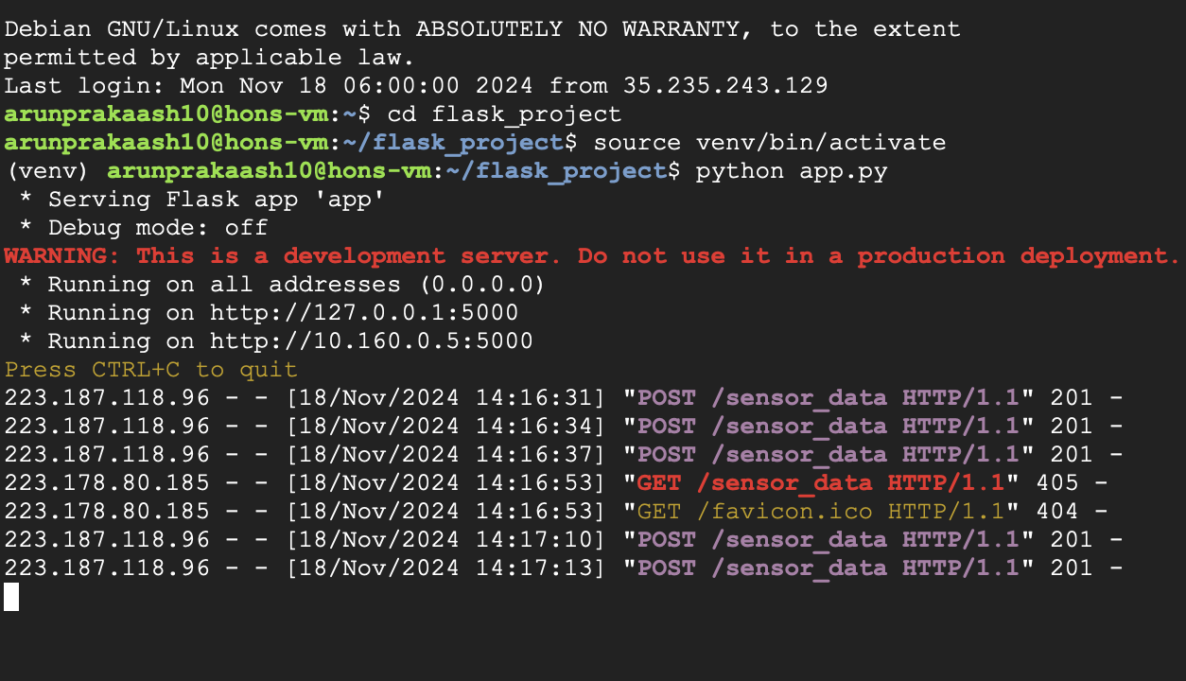
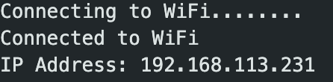
ELECTRONICS SUBSYSTEM
Wi-Fi Communication and Cloud Integration:
ESP32 Connectivity:
Configured to connect to a Wi-Fi network for bidirectional communication.
Flask API on Google Cloud VM:
Facilitates real-time data transmission.
Enables remote control over actuators.
Serial line Wi-Fi status output
REST API – Data Reception, Logging and Error Handling

Slide 18
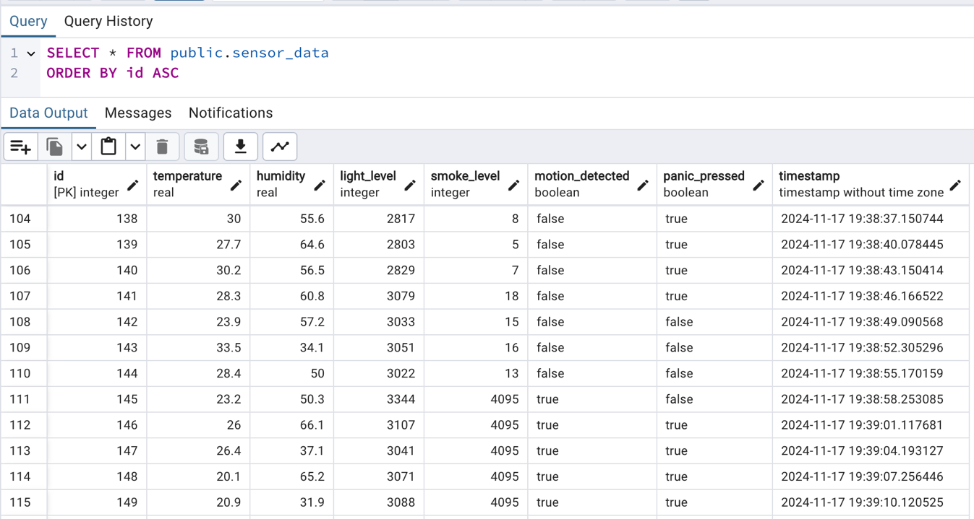
ELECTRONICS SUBSYSTEM
Communication Workflow:
ESP32 collects and processes sensor data.
Data sent as JSON payloads via HTTP POST requests to Flask API.
Flask API handles data storage and retrieval in PostgreSQL database.
‘sensor_data’ cloud-SQL table contents

Slide 19
Visualization and Monitoring
A user-friendly interface was developed using Microsoft Power Apps to visualize database contents:
Dashboard Features: The main dashboard displayed surveillance report and sensor data. Users could access detailed logs by navigating to specific entries.
Responsiveness: Updates were reflected in real-time, ensuring actionable insights for safety officials.

Slide 20
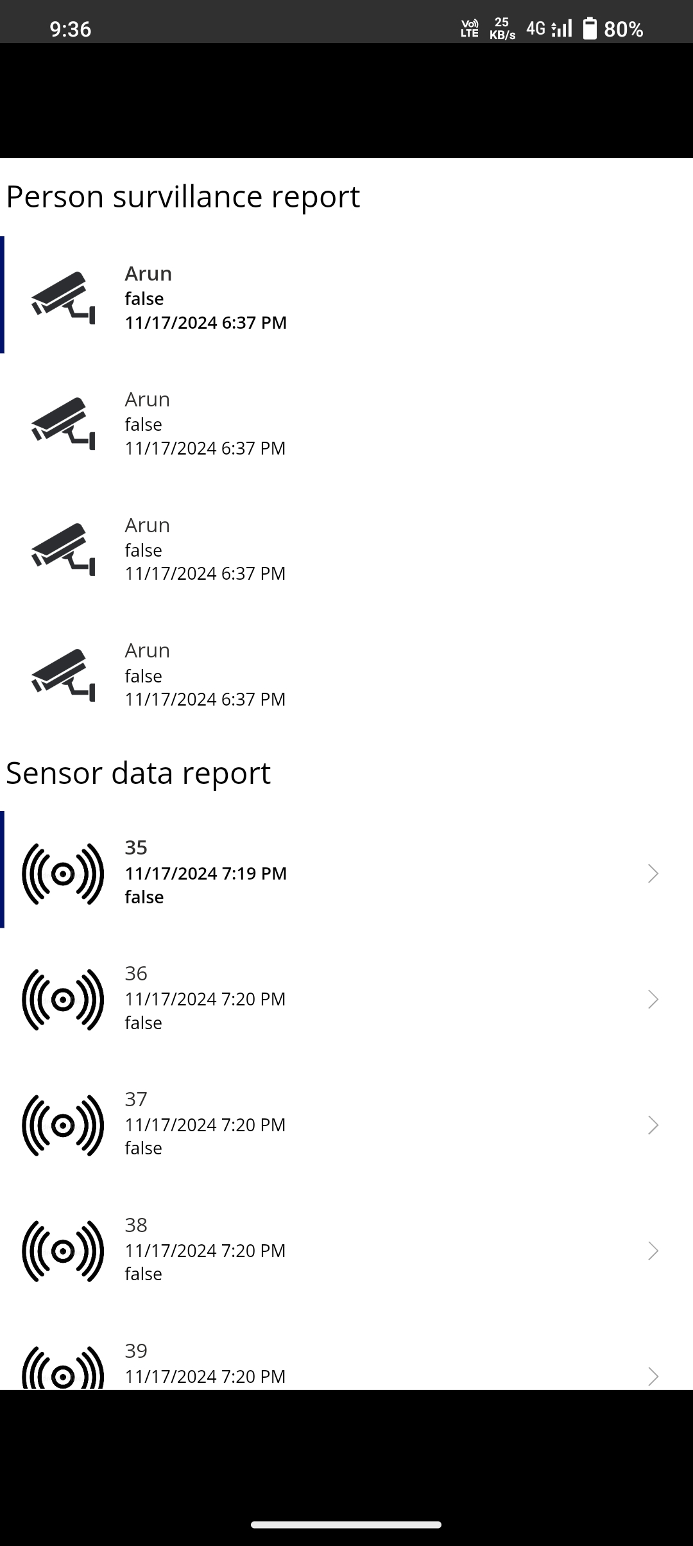
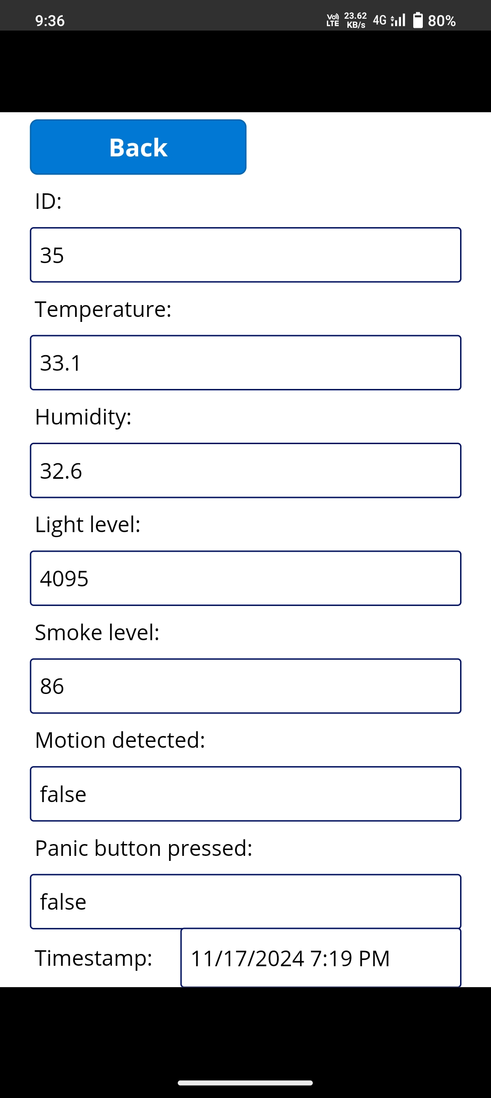
Visualization and Monitoring
In App data visualization

Slide 21
CONCLUSION
Successfully implemented smart surveillance systems capable of real-time monitoring in restricted areas, ensuring rapid threat detection and improved safety.
Integrated intelligent fire detection and prevention mechanisms to deliver early warnings and facilitate swift responses to fire incidents.
Deployed adaptive street lighting solutions that dynamically adjust brightness based on pedestrian and vehicular activity, significantly enhancing visibility and security in dimly lit areas.
Installed smart panic buttons in public spaces, empowering citizens to promptly alert authorities and ensuring immediate assistance during emergencies.
A centralized cloud server aggregates real-time data from sensors and surveillance systems, while a user-friendly interface app offers live monitoring and actionable insights to officials, enhancing decision-making and emergency management.

Slide 22
REFERENCES
S. Ebadinezhad, M. S. M. Abdalkarim, Z. Deen, and F. M. Kiminou Nsimba, "The Role of IoT in Enhancing Public Safety in Smart Cities," 2020 International Conference on Smart Cities and Applications (SCA), Berlin, Germany, 2020, pp. 98-104, doi: 10.1109/SCA2020.2020.9153057.
M. B. Lam, T.-H. Nguyen, and A.-Y. Chung, "A Framework for Integrating Autonomous Systems in Disaster Management," IEEE/CAA Journal of Automatica Sinica, vol. 7, no. 5, pp. 1234-1245, Sep. 2020, doi: 10.1109/JAS.2020.1003287.
R. Singh, R. Sharma, K. Kumar, M. Singh, and P. Vajpayee, "IoT-Based Earthquake and Fire Detection System for Emergency Response," in Proceedings of the 2020 IEEE International Conference on Intelligent Systems and Applications (ICISA), Tokyo, Japan, 2020, pp. 245-251, doi: 10.1109/ICISA.2020.1013412.
Z. Wu, Y. Jiang, and T. Zheng, "IoT-Based Emergency Response System with Predictive Analytics," IEEE Internet of Things Journal, vol. 7, no. 6, pp. 5553-5562, Dec. 2020, doi: 10.1109/IoTJ.2020.2987728.
P. Pace, G. Aloi, and G. Caliciuri, "Infrastructureless IoT Wireless Mesh Network for Disaster Scenarios," IEEE Transactions on Network and Service Management, vol. 17, no. 4, pp. 2561-2570, Dec. 2020, doi: 10.1109/TNSM.2020.3034456.
A. Homaifar, A. Girma, and M. Sarkar, "UAV and UGV Collaboration Framework for Disaster Management Using MQTT Protocol," IEEE/CAA Journal of Automatica Sinica, vol. 7, no. 5, pp. 1249-1262, Sep. 2020, doi: 10.1109/JAS.2020.1003291.

Slide 23
THANK YOU

